Slide 1
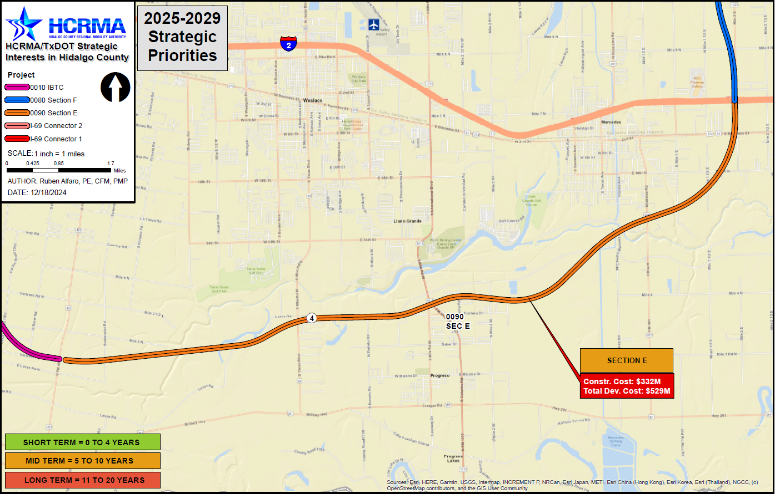

Section E
http://www.hcrma.net

Slide 2
Section E
PROJECT LIMITS:
FROM: IBTC,EAST CONNECTOR
TO: 1-2, ~1 MILES EAST OF MILE 1 EAST
LENGTH: 12.75 MILES
ESTIMATED COST: $528,622,500.00
PROPOSED LETTING DATE: FY 2035
NEXT STEPS:
EXECUTE ENVIRONMENTAL CLEARANCE
CONTRACT AND BEGIN PROCESS
DEFINE FINAL ROUTE AS PART OF PROCESS
CHALLENGES:
TO BE DETERMINED BASED ON
FINAL ROUTE
COST BREAKDOWN:
MANAGEMENT SUPPORT | $4,972,500.00
PRELIMINARY ENGINEERING | $16,575,000.00
FINAL DESIGN | $23,205,000.00
ROW ACQUISITION | $92,700,000.00
UTILITY RELOCATION | $16,575,000.00
CONSTRUCTION | $348,075,000.00
CONSTRUCTION MANAGEMENT | $26,520,000.00
TOTAL DEVELOPMENT COST | $528,622,500.00
PROPOSED FUNDING:
TOLL REVENUE BONDS
PRIORITY
4

