Slide 1
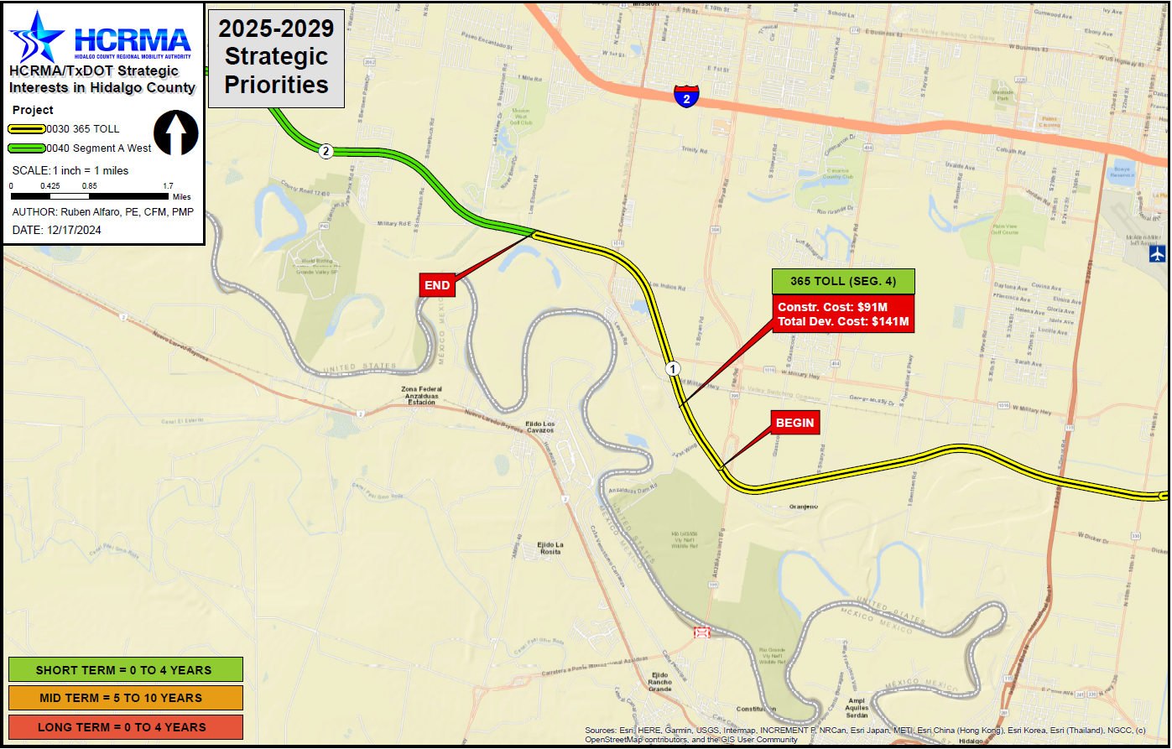

365 toll segment 4
http://www.hcrma.net

Slide 2
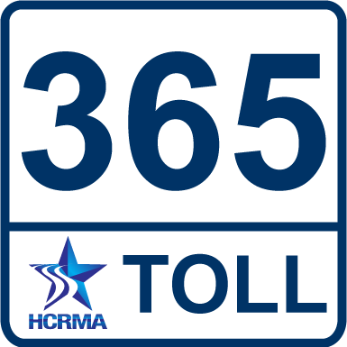
365 toll segment 4
PROJECT LIMITS:
FROM: FM 1016/CONWAY AVE.
TO: FM 396/ANZALDUAS HIGHWAY
LENGTH: 3.47 MILES
ESTIMATED COST: $140,681,600.00
PROPOSED LETTING DATE: FY 2029
NEXT STEPS:
ENVIRONMENTAL REFRESHER
ROW ACQUISITION
PS&E DEVELOPMENT
CHALLENGES:
FUNDING TBD
COST BREAKDOWN:
MANAGEMENT SUPPORT | $1,353,300.00
PRELIMINARY ENGINEERING | $1,353,300.00
FINAL DESIGN | $6,315,400.00
ROW ACQUISITION | $25,200,000.00
UTILITY RELOCATION | $4,511,000.00
CONSTRUCTION | $94,731,000.00
CONSTRUCTION MANAGEMENT | $7,217,600.00
TOTAL DEVELOPMENT COST | $140,681,600.00
PROPOSED FUNDING:
TOLL REVENUE BONDS
PRIORITY
1

