Slide 1
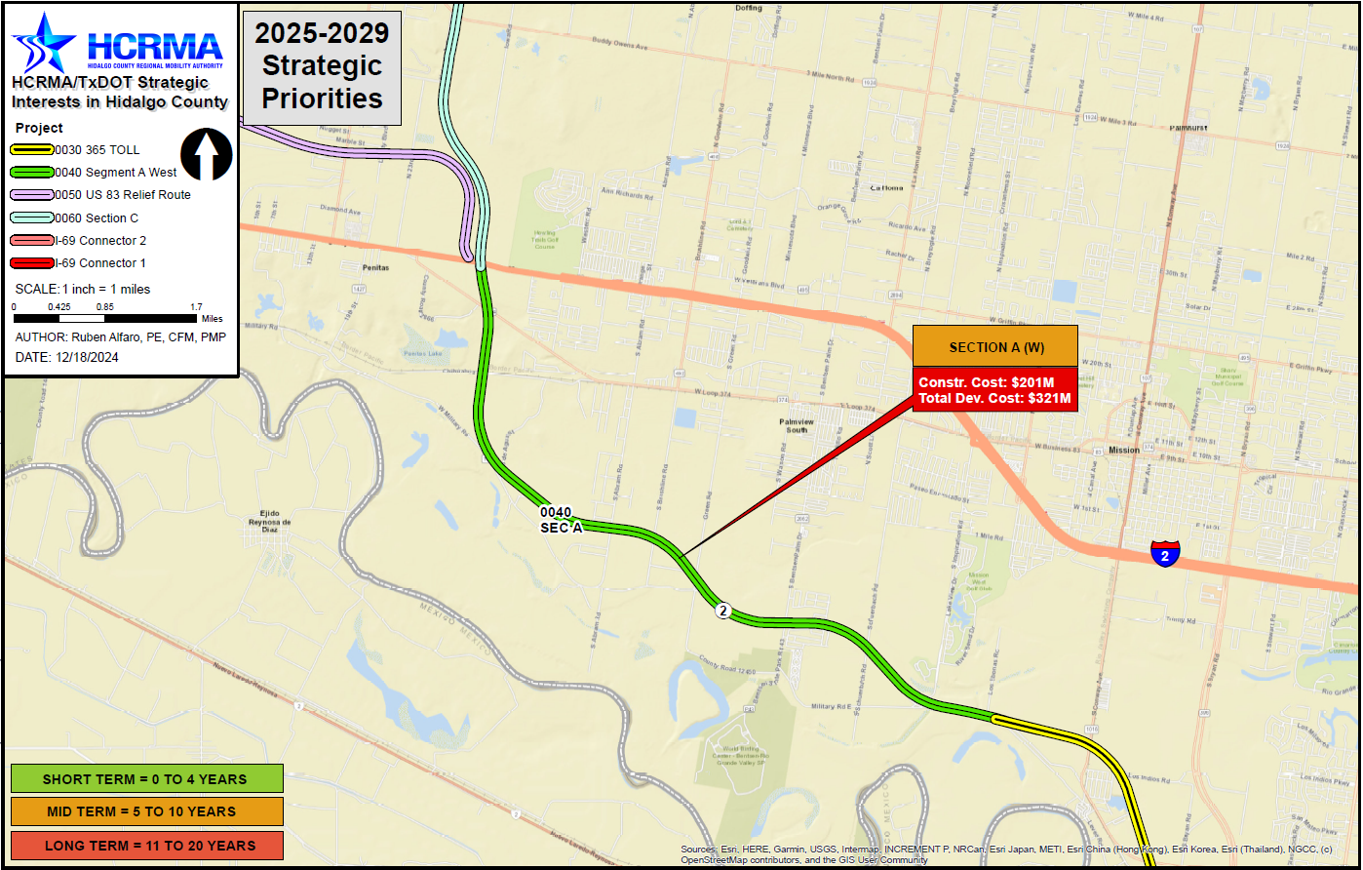

Section a (west)
http://www.hcrma.net

Slide 2
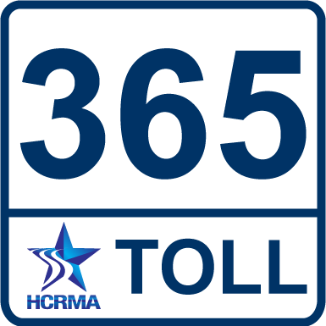
Section a (west)
PROJECT LIMITS:
FROM: I-2, 0.8 MILES WEST OF SHOWERS RD.
TO: FM 1016/CONWAY AVE.
LENGTH: 7.73 MILES
ESTIMATED COST: $320,538,700.00
PROPOSED LETTING DATE: FY 2033
NEXT STEPS:
EXECUTE ENVIRONMENTAL CLEARANCE
CONTRACT AND BEGIN PROCESS
DEFINE FINAL ROUTE AS PART OF PROCESS
CHALLENGES:
CURRENT ROUTE PRESENTS SEVERAL RESIDENTIAL DISPLACEMENTS
CURRENT ROUTE TRAVERSES FEDERALLY PROTECTED LAND
COST BREAKDOWN:
MANAGEMENT SUPPORT | $3,014,700.00
PRELIMINARY ENGINEERING | $10,049,000.00
FINAL DESIGN | $14,068,600.00
ROW ACQUISITION | $56,250,000.00
UTILITY RELOCATION | $10,049,000.00
CONSTRUCTION | $211,029,000.00
CONSTRUCTION MANAGEMENT | $16,078,400.00
TOTAL DEVELOPMENT COST | $320,538,700.00
PROPOSED FUNDING:
TOLL REVENUE BONDS
PRIORITY
2

