Slide 1
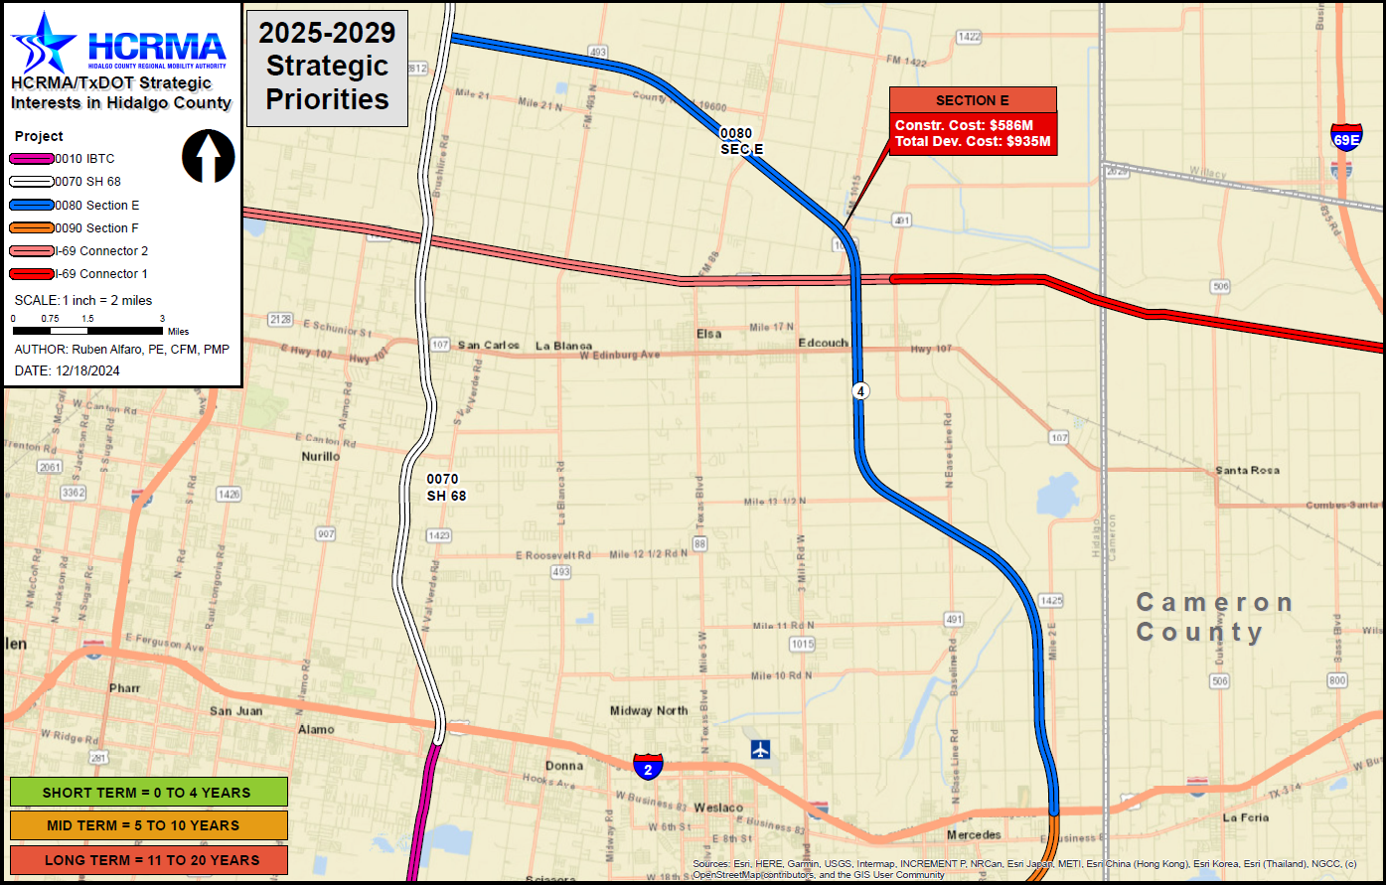

Section e
http://www.hcrma.net

Slide 2
Section e
PROJECT LIMITS:
FROM: I-2, ~1 MILES EAST OF MILE 1 EAST
TO: SH 68, ~0.88 MILES NORTH OF FM 2812
LENGTH: 22.53 MILES
ESTIMATED COST: $934,100,700.00
PROPOSED LETTING DATE: FY 2037
NEXT STEPS:
EXECUTE ENVIRONMENTAL CLEARANCE
CONTRACT AND BEGIN PROCESS
DEFINE FINAL ROUTE AS PART OF PROCESS
CHALLENGES:
TO BE DETERMINED BASED ON
FINAL ROUTE
COST BREAKDOWN:
MANAGEMENT SUPPORT | $8,786,700.00
PRELIMINARY ENGINEERING | $29,289,000.00
FINAL DESIGN | $41,004,600.00
ROW ACQUISITION | $163,800,000.00
UTILITY RELOCATION | $29,289,000.00
CONSTRUCTION | $615,069,000.00
CONSTRUCTION MANAGEMENT | $46,862,400.00
TOTAL DEVELOPMENT COST | $934,100,700.00
PROPOSED FUNDING:
TOLL REVENUE BONDS
PRIORITY
5

