Slide 1
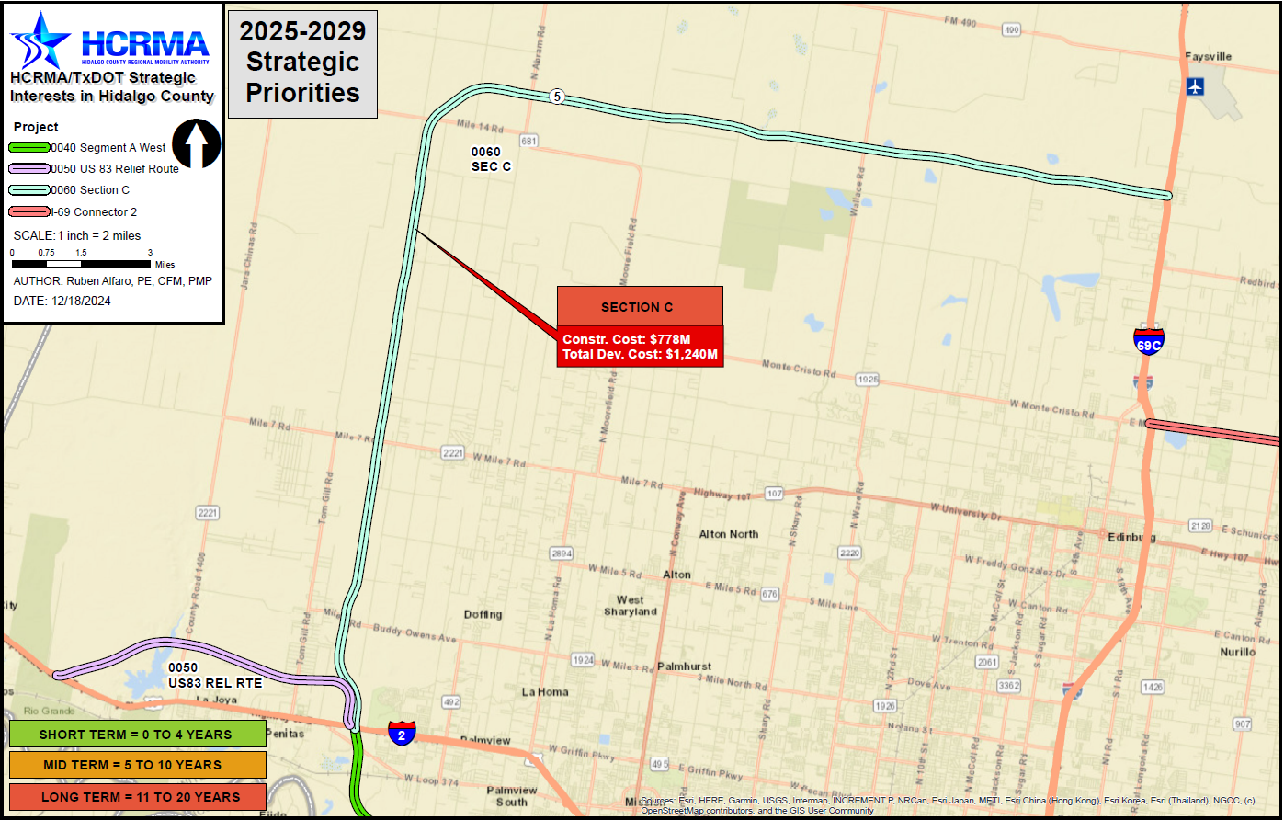

Section c
http://www.hcrma.net

Slide 2
Section c
PROJECT LIMITS:
FROM: I-2, 0.8 MILES WEST OF SHOWERS RD.
TO: I-69C, 0.6 MILES SOUTH OF FM 162
LENGTH: 29.89 MILES
ESTIMATED COST: $1,239,289,100.00
PROPOSED LETTING DATE: FY 2039
NEXT STEPS:
EXECUTE ENVIRONMENTAL CLEARANCE
CONTRACT AND BEGIN PROCESS
DEFINE FINAL ROUTE AS PART OF PROCESS
CHALLENGES:
TO BE DETERMINED BASED ON
FINAL ROUTE
COST BREAKDOWN:
MANAGEMENT SUPPORT | $11,657,100.00
PRELIMINARY ENGINEERING | $37,857,000.00
FINAL DESIGN | $54,399,800.00
ROW ACQUISITION | $217,350,000.00
UTILITY RELOCATION | $38,857,000.00
CONSTRUCTION | $815,997,000.00
CONSTRUCTION MANAGEMENT | $62,171,200.00
TOTAL DEVELOPMENT COST | $1,239,289,100.00
PRIORITY
PROPOSED FUNDING:
TOLL REVENUE BONDS
3

